Slide 1
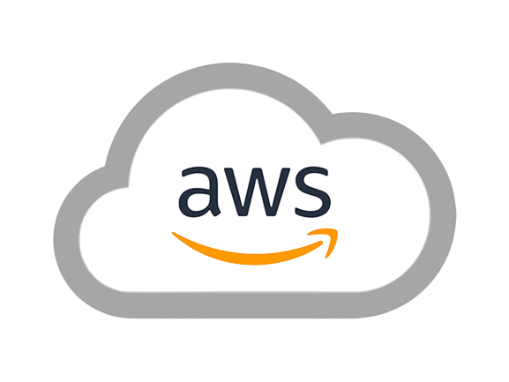
End to End
Virtual Private Cloud
with RDS
BY
KORADA VIJAYA ANJALI
ADITYA UNIVERSITY
21A91A6148

Slide 2
INDEX
INTRODUCTION
TECHNOLOGIES USED
ADAVANTAGES OF VPC
DEPLOYMENT
RESULTS
CONCLUSION

Slide 3
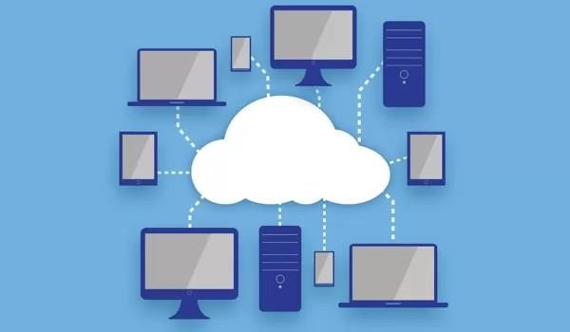
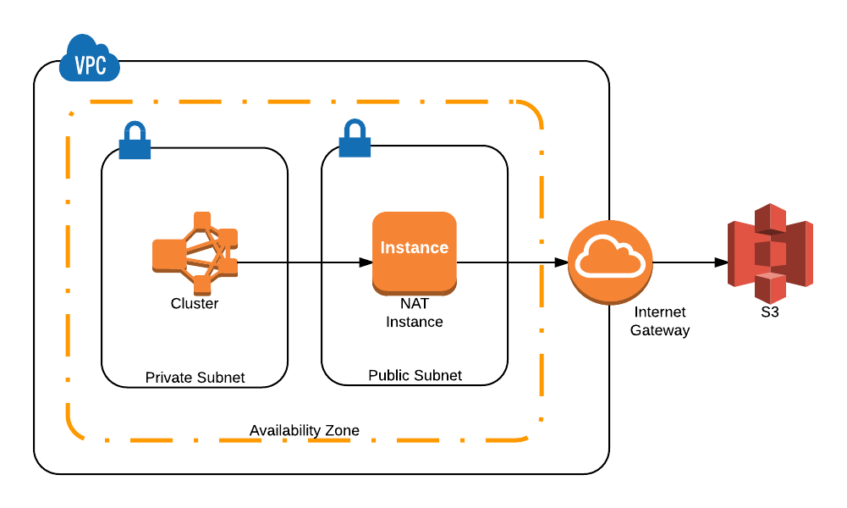
01. Introduction
Cloud is the delivery of computing services including servers, storage, databases, networking, software, and more over the internet ("the cloud").
A Virtual Private Cloud (VPC): is a secure, isolated section of a public cloud where users can launch resources in a virtual network they define. It provides control over the network environment, including IP address ranges, subnets, route tables, and network gateways
Amazon RDS (Relational Database Service): is a managed database service that simplifies setting up, operating, and scaling a relational database in the cloud.

Slide 4
02.TECHNOLOGIES USED
AWS
VPC
RDS (MySQL)
EC2
APACHE SERVER
GITHUB

Slide 5
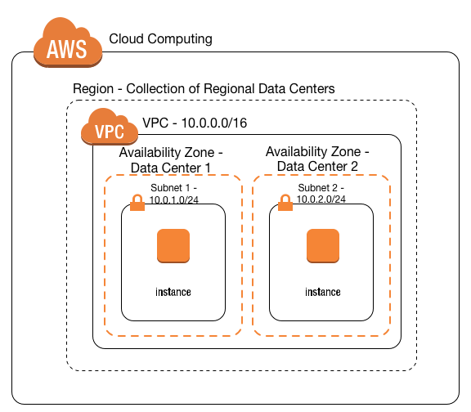
03. Advantages of VPC
Controlled Access
Scalability
Optimized Resource Placement
Improved Security Layers
Cost Management
Ease of Maintenance
Compliance

Slide 6
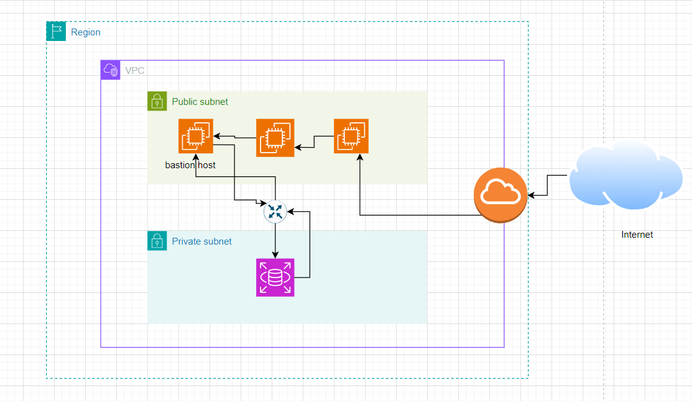
04. DEVELOPMENT

Slide 7
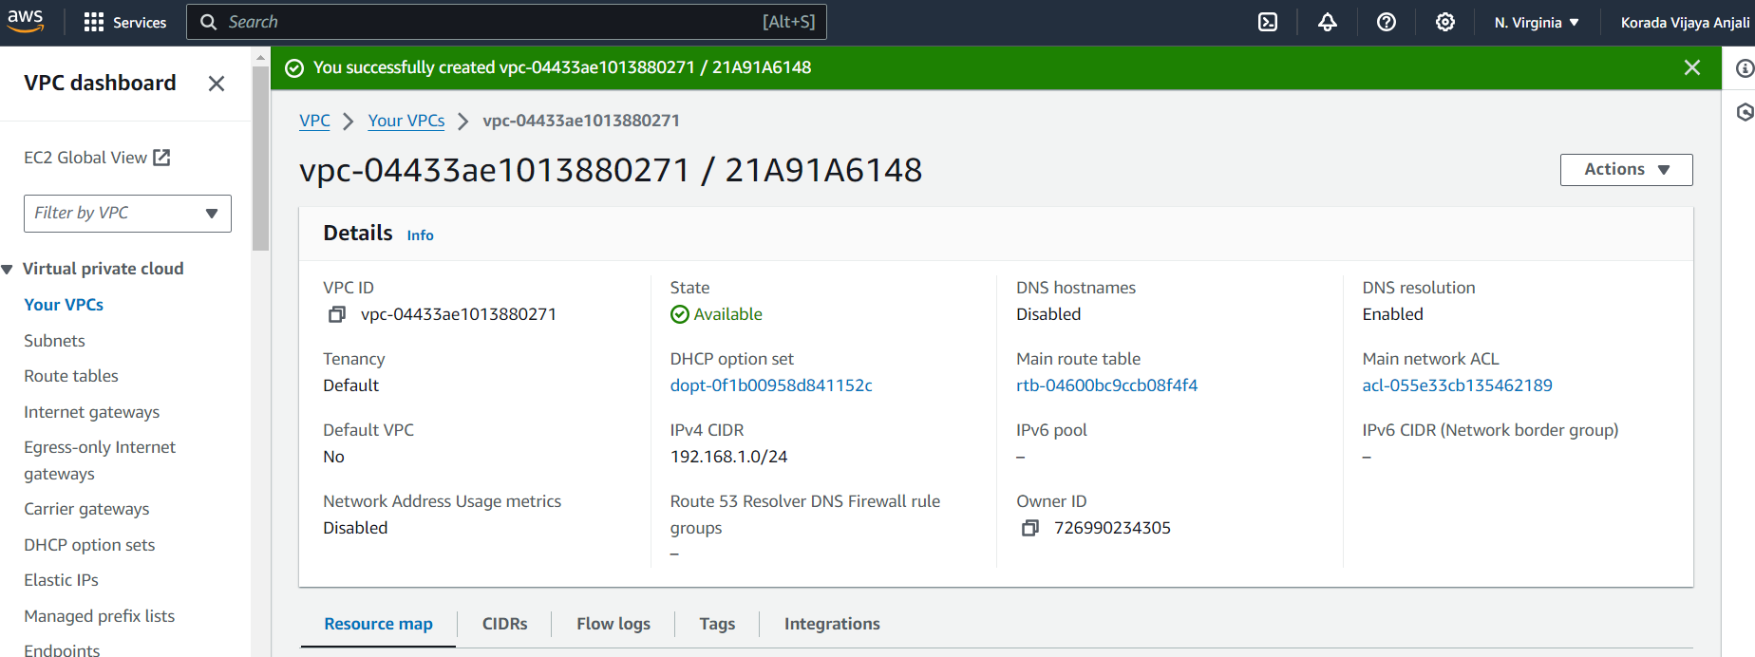
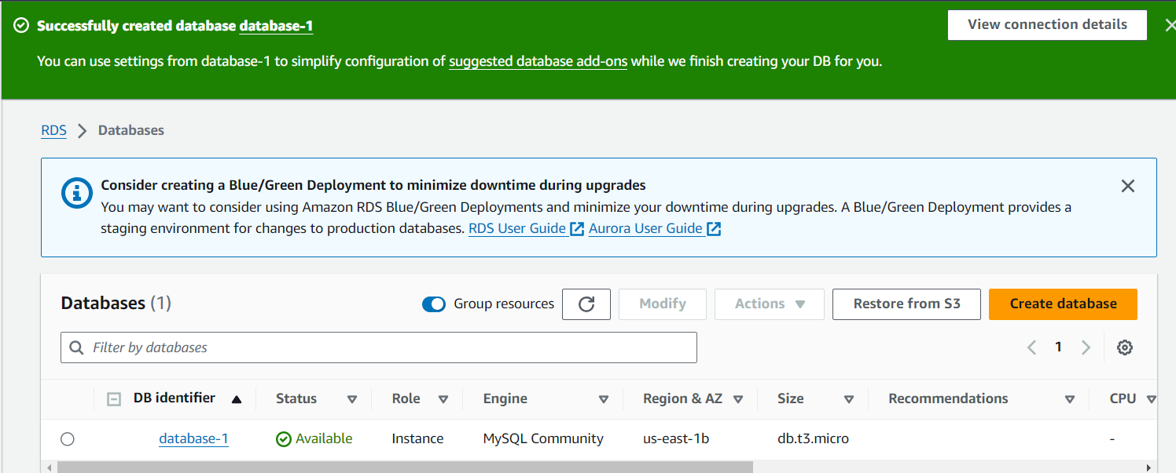
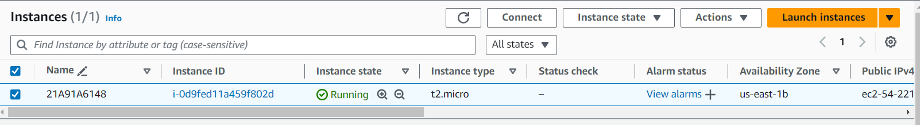
05.RESULTS

Slide 8
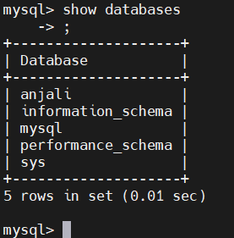
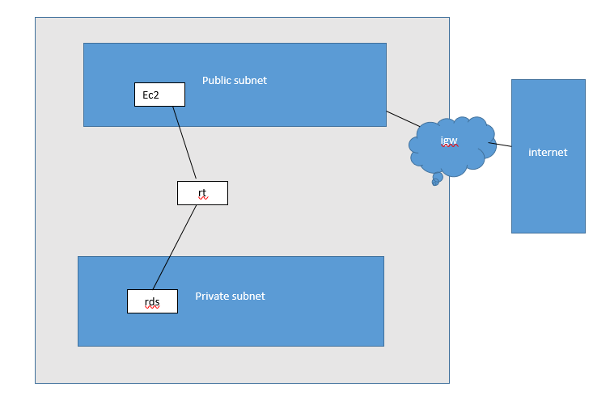

Slide 9
06. CONCLUSION
In this project, I successfully designed and implemented a Virtual Private Cloud (VPC) architecture with distinct public and private subnets to optimize security and functionality. By deploying EC2 instances in the public subnet, equipped with a bastion host, I ensured secure access to the internet and management of resources.
The private subnet housed the database, protected from direct internet exposure, and was accessed securely through the bastion host using Amazon RDS. The deployment of a website on the public EC2 instance, along with the configuration of an Internet Gateway (IGW), route tables (RT), and a NAT gateway (NAT), demonstrated a robust and scalable infrastructure solution.This setup not only met security and performance requirements but also showcased effective network design and resource management.

Slide 10


